Slide 1
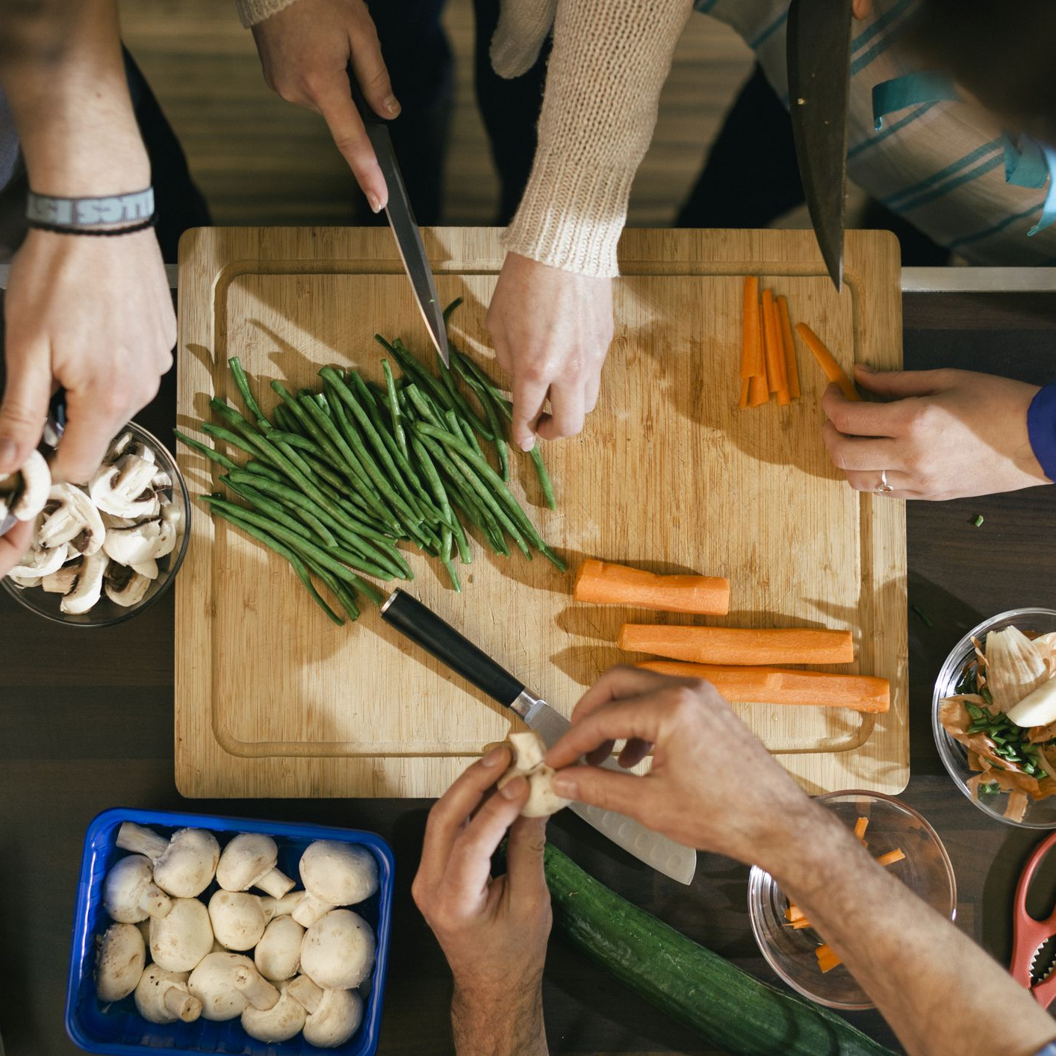


Presents:
Homely
By Samantha Zhan & Melinda Xie

Slide 2
TABLE OF CONTENTS
The Purpose
01
03
Function
Impact
02
04
Technical Aspects
03
What the app is about
The basic and unique functions of our app
Potential target audiences
The tools we used for development

Slide 3
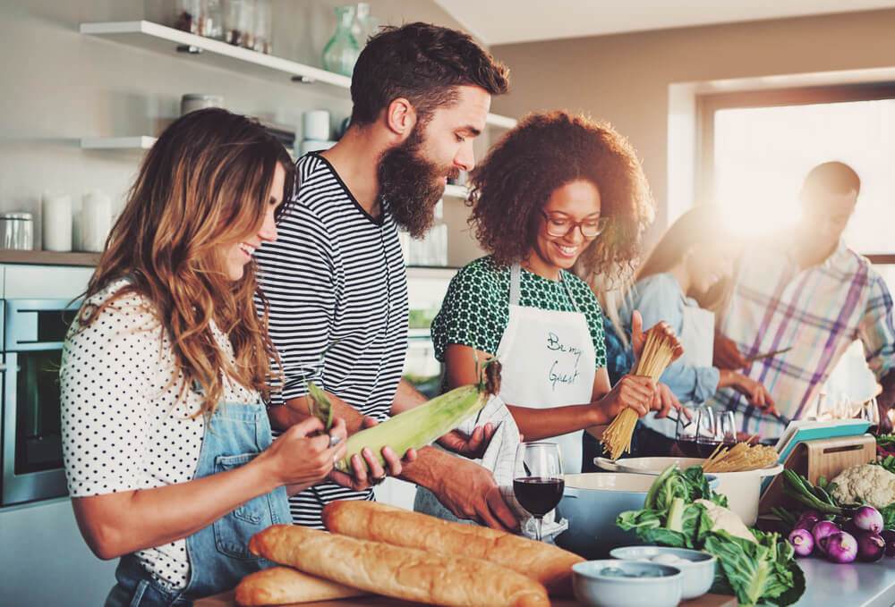
OUR APP
Home cooking: the Trend:
With more and more people started to cook at home during the pandemic. There is an emerging trend that more people will come out of quarantine with some cooking skills. Home cooking is seen as one of the best habit to gain, because it can help:
Save Money: much cheaper than eating out
Healthier: know what is in your food
Portion control/diet
Bring family or friends together
With more and more people returning to work or school, a convenient app is handy for them to keep up with the good habit and become better mentally and physically

Slide 4
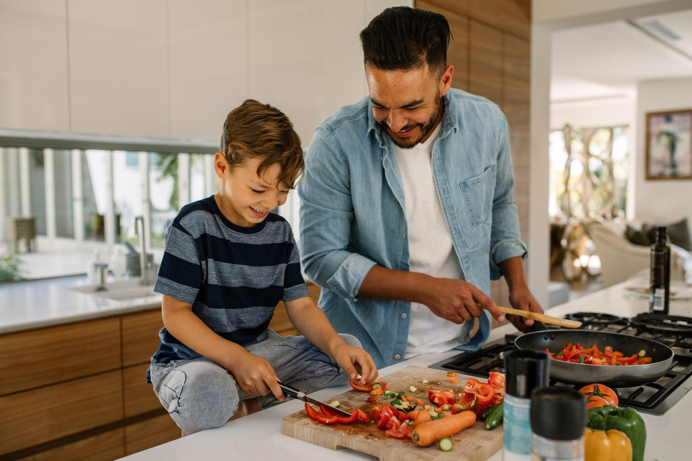
OUR APP
Our Mission:
Our mission is to make home cooking a simple, intuitive, and enjoyable thing to do. Our idea come from our passion for food and home cooking. With years of cooking experiences, we summarized the problems and inconvenience we faced when we cook. We believe our app, Homely, is a great solution for it.

Slide 5



Our themes
University Life
Post Pandemic
AI & Algorithm
University student looking for a budget friendly, healthier way of eating without the hustle. Step by step planning and cooking instructions
More people have the time to give home cooking a try
Eliminate the unsafe factor of eating out
More traction towards home-cooking
There are potential way to make the app even smarter and more efficient using AI and algorithms.

Slide 6
Impact on different crowds
University Students(beginners)
Students who live alone and have heavy workload. They tend to:
eat more unhealthy food
concerned about body shape.
Budget is another important factor for them.
Busy office workers
Cooking from home is very hard for them because of their tight schedule;
have the financial power to purchase healthier food but don’t have time to cook
more health-concerned
Family
Parents who are experienced in cooking but
looking for a not so difficult upgrade to daily meals
Need a tool to keep everything organized

Slide 7






Features
Six Stages of Home Cooking
The planning stage
Execution
Go grocery shopping
Enjoy!
Look for recipes
Plan for the week
Cook!
Repeat
Motivation

Slide 8








Marketing research & competitor analysis
Recipe database powered by Spoonacular API
Adobe Xd
Networking & API
UI Design
Technical Aspects
Android studio(Java)
Development platform
MPV Model
APP Structure
Working with JSON
HTML & CSS
Data Presentation
SQLite
User data storage

Slide 9


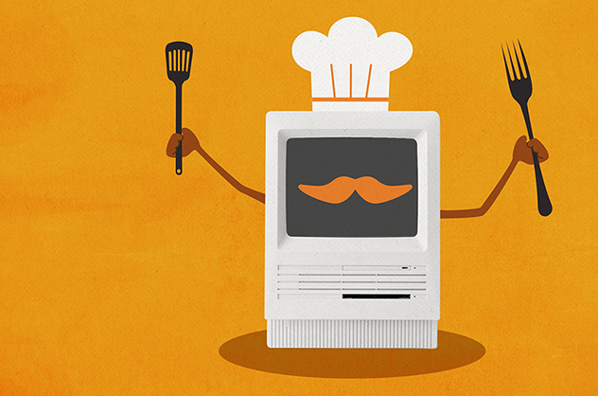

Future implementation of AI:
Program helper virtual robot for giving tips and finding exactly what the user want to eat based on broad descriptions.
Use algorithm to calculate user’s favourites meal type and make recommendations.
Smarter way of planning: work around your schedule and gives suggestion of when to do what. Prepare ahead and multitasking to make cooking easier
and much more!

Slide 10
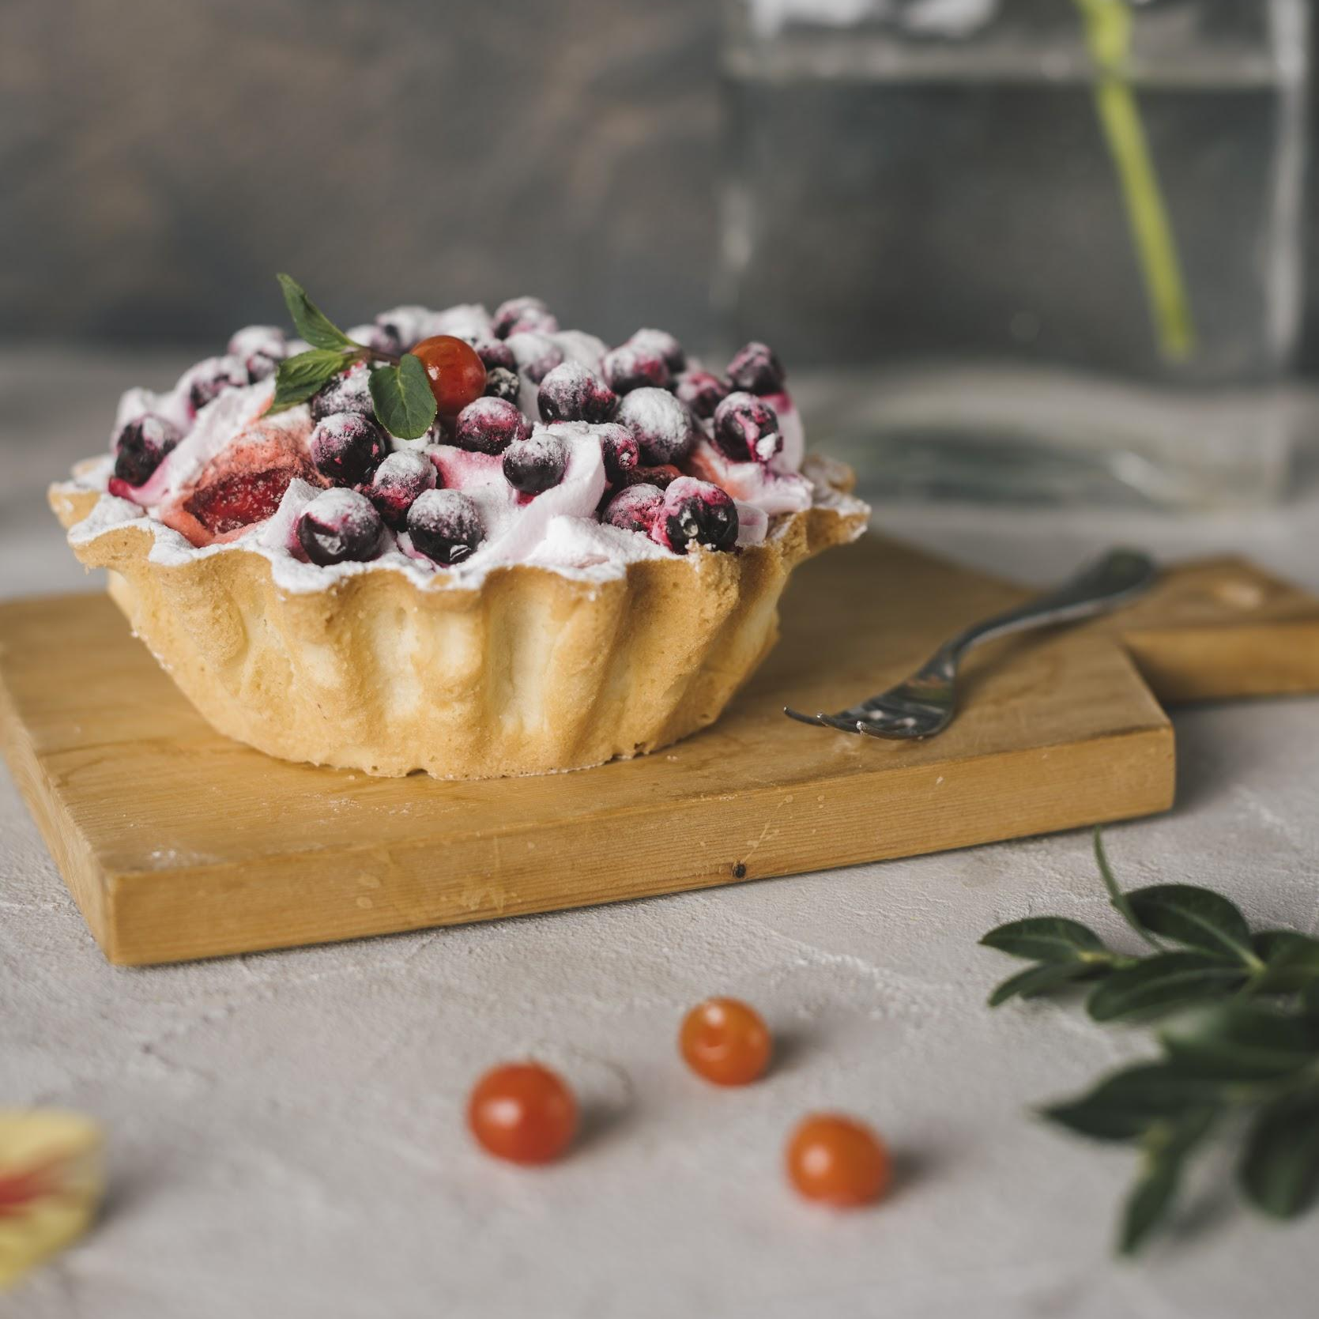
THANKS
Any questions?

